Slide 1
LIBRARY MANAGEMENT SYSTEM

Slide 2
AIM OF THE PROJECT
A library book management is a project that manages and stores book information electronically according to students’ needs. The system helps the library manager to keep constant track of all the books available in the library.
It allows both the admin and the librarian to search for the desired book. It becomes necessary for schools and colleges to keep a continuous check on the books issued and returned.
This task if carried out manually will be tedious and includes chances of mistakes.
Thus this system reduces manual work to a great extent and allows a smooth flow of library activities by removing chances of errors in the details.

Slide 3
OBJECTIVE OF THIS PROJECT
This project system was highly recommended due to the rapid increase of computer related tools in the industry.
With this proposed system features and functions of the e-library that will be able to accommodate more reliably consistently and faster in providing a better service to the users.

Slide 4

SOFTWARE AND HARDWARE REQUIREMENTS
HARDWARE REQUIREMENTS:
Processor : intel i5
Motherboard : intel 915gvsr chipset board
Ram : 4 gb ddr2 ram
Hard disk drive : 160 gb
SOFTWARE REQUIREMENTS:
Front end : Java Swing
Back end : mysql, java

Slide 5
PROPOSED SYSTEM
Proposed system is an automated Library Management System. Through our software an admin can add Librarian, view librarian, delete librarian. And Librarian can add books , issue books, return books, view issued books.
. User friendly interface
. Fast access to database
. Less error
. More Storage Capacity
. Search facility
. Look and Feel Environment
. Quick transaction

Slide 6
ADVANTAGES OF PROPOSED SYSTEM
The system excludes the use of paper work by managing all the book information electronically.
Admin can keep updating the system by providing the new books arrival in system and their availability thus students need not to go to library for issuing purpose.
The system has books well organized and systematically arranged in different categories in the system so that user can easily search and find the book.
Thus, it saves human efforts and resources.

Slide 7
MODULE LIST
Librarian
Login
Add books
View Books
Issue Books
View issued books
Return Books
Logout

Slide 8
MODULE LIST
ADMIN
Login
Add Librarian
View Librarian
Delete Librarian
Logout

Slide 9
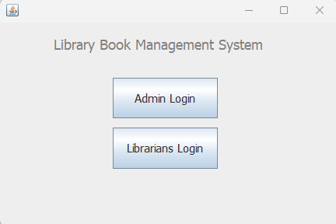
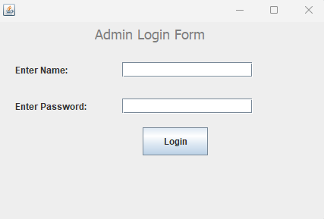
SCREENSHOTS

Slide 10
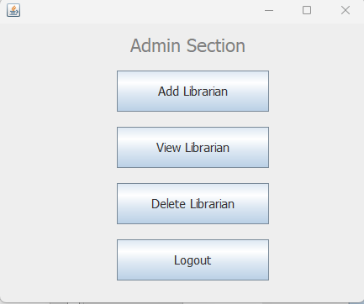
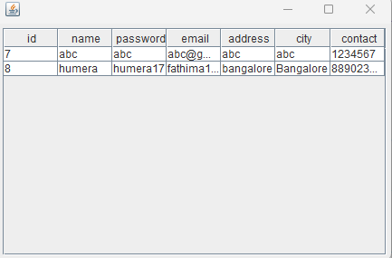

Slide 11
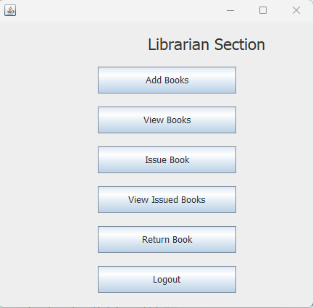
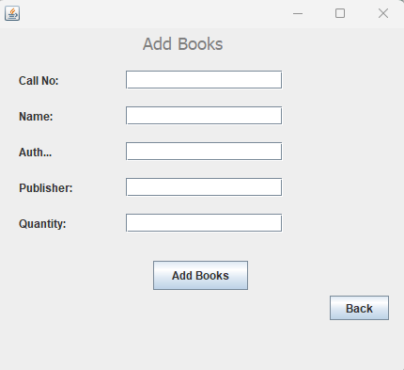

Slide 12
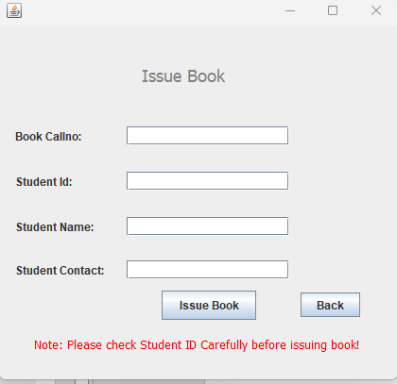
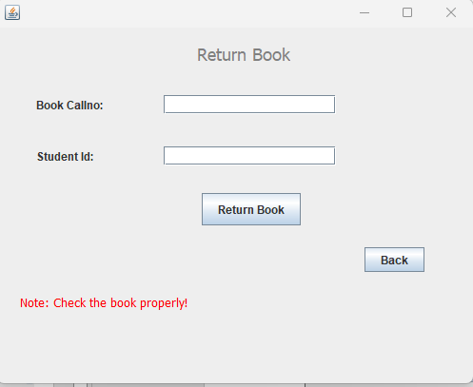

Slide 13
CONCLUSION
Hence we have designed the project to provide the user with easy navigation, retrieval of data, and necessary feedback as much as possible.
In this project, the user is provided with an online system that can be used to issue and return books in library management online
This project helps in understanding the creation of interaction and the transparency between the student and the librarian of the books through the system.

Slide 14
FUTURE ENHANCEMENT
In Future work, This application to develop a cross platforms like IOS, etc.
In adding the more features of online library management system to develop access with user’s flexibility.
To authenticate the users based on the system users list which is maintained by the operating system
To restrict the usage of all files by the users based on their privileges on the system

